Slide 1
Improper Payments Initiative
Why this is a key priority for VA?
Reducing improper payments is VA’s #1 financial management priority
The President and the Office of Management and Budget (OMB) have made eliminating waste, fraud, and abuse in Federal programs, including reducing and recapturing erroneous payments, one of its top financial goals
The March 2012 VA OIG report found VA non-compliant with the Improper Payments Elimination and Recovery Act (IPERA) of 2010
In FY 2011 PAR VA reported $2.4 billion in improper payments and an IP rate of 2.65%. For 2012, VA estimates a total of $2.2 billion in improper payments and an IP rate of 3.4%. Trends show that rates are increasing.
Goals to be accomplished
Reduce the number and value of improper payments made by VA
Improve improper payment identification and reporting processes
Comply with the provisions of IPERA

Slide 2
Commercial Small Business Payments
Note: OMB instructed Agencies to accelerate payments to small businesses with the goal of paying small businesses within 15 days of receipt of appropriate documentation. Delivery of goods and acceptance of services must still occur before making payment. VA has for many years used existing authority in the Prompt Payment Act to accelerate commercial vendor small business payments after receiving all proper documentation, including acceptance. Entities designated as small businesses are submitted for payment through FMS (not money managed) when acceptance occurs.
November Highlights:
VA paid 93 percent of small business invoices in November within the 15 day timeliness metric bettering the VA goal
Station 791 (Denver Acquisition and Logistics Center) continues a new high volume small business contract for the repair of hearing aids which were paid within the 15 day timeliness metric which has helped boost payment timeliness
FSC has issued a notice to VA stations highlighting the OMB goal and encouraged timely certification of invoices and receipt processing during VHA Fiscal Officers Calls
FSC has used mail campaigns to vendors to promote ways to shorten the payment cycle time and obtain payment information by using Electronic Funds Transfer (EFT), Electronic Invoicing, Central Contractor Registration (CCR), and FSC’s Vendor Inquiry System (VIS) web portal to monitor payment information
FSC continues to analyze small business payment data to identify opportunities to further increase payment timeliness and will work with Administrations/Stations to identify causes for delayed payments and potential procedures for accelerating payments
Prepared by: Kevin Miers, Systems & Procedures Analyst, VA Financial Services Center, Kevin.Miers@va.gov
Approved by: Robert Adams, Deputy Director, VA Financial Services Center, (512) 460-5002
Version Date: December 7, 2012

Slide 3
Metric:
Linkages
Org | OM (Finance)
B/Line | Enabling
B/Scorecard | Operations
Strategic Goal | 4
Corp Outcome | Improve Management and Support Services Timeliness and Quality
Status
Current Month (Nov)
Next Month (Dec)
Projected Green Date | N/A
Monthly Actual | 93%
FYTD Actual | 94%
Commercial Small Business Payment Timeliness
G
G
Metric ID | OM (Finance)-197
Timeliness Exceeds Goal
↑
Desired
Direction
Percent Paid Within 15 Days of Receipt of Proper Payment Documentation
↓
Desired
Direction
Variance Thresholds
Red | ≤ -10%
Yellow | ≤ -5%
Green | > -5%
Notes:
Metric Format - Percentage

Slide 4
Overall Commercial Vendor Payment Timeliness
Note: Overall Commercial Vendor Payment Timeliness measures VA vendor payment timeliness against the July 2012 OMB guidance to pay all commercial vendors within 15 days of receipt of all payment documentation. Delivery of goods and acceptance of services must still occur before making payment.
November Highlights:
During November, VA paid 85 percent of all commercial vendors within the 15 day OMB goal
FSC paid 89 percent of November’s payments within the 15 day goal
Non-FSC entities paid 83 percent of all commercial vendors within the 15 day OMB goal
Prepared by: Kevin Miers, Systems & Procedures Analyst, VA Financial Services Center, Kevin.Miers@va.gov
Approved by: Robert Adams, Deputy Director, VA Financial Services Center, (512) 460-5002
Version Date: December 7, 2012

Slide 5

Metric:
Linkages
Org | OM (Finance)
B/Line | Enabling
B/Scorecard | Operations
Strategic Goal | 4
Corp Outcome | Improve Management and Support Services Timeliness and Quality
Status
Current Month (Nov)
Next Month (Dec)
Projected Green Date | N/A
Monthly Actual | 85%
FYTD Actual | 83%
G
G
Overall Commercial Vendor Payment Timeliness
G
Metric ID | OM (Finance)-198
Timeliness Above Goal
↑
Desired
Direction
Percent Paid Within 15 Days of Receipt of Proper Payment Documentation
↓
Desired
Direction
Variance Thresholds
Red | ≤ -10%
Yellow | ≤ -5%
Green | > -5%
Notes:
Metric Format - Percentage

Slide 6
Linkages
Org | OM
B/Line | Enabling
Metric Type | Performance
B/Scorecard | Operations
Initiative | N/A
Strategic Goal | 4
Corp Outcome | Improve Management and Support Services Timeliness and Quality
Metrics Detail: Commercial Interest Penalties Summary FY 2013 IPM Performance Betters FY 2013 goal [Results Data in Green = Improvement From Previous Month]
*The monthly, FYTD, and annual goal for this measure is the same.
**No annual goal for total dollar value interest penalties.
Data Through November 2012
Notes:
6
6

Slide 7
Note: The FY 2013 interest per million dollars disbursed goal $13 for commercial payments subject to Prompt Pay Act (PPA) reflects a 5 percent improvement over the FY 2012 actual performance level.
November Highlights:
VA Commercial Interest Per Million (IPM) increased from $7 in October to $12 for November. However, the FY 2013 IPM level of $10 is 33 percent better than the FYTD 2012 performance level ($14) for the same period.
IPM on FSC processed commercial payments increased from $5 in October to $12 in November. However, FSC’s FYTD 2013 IPM level of $8 is 26 percent better than the FYTD 2012 performance level ($11).
FSC saw an increase in the numbers of invoices paying interest. The majority were caused by station delay and were low dollar value (under $50) in interest. The largest payment was $362.10. November’s IPM of $12 was consistent with last year ($11) and we typically see an increase in our IPM rate November through Feb (holiday effect). However, we feel it is a seasonal anomaly and do not believe this will prevent us from meeting the FY 2013 goal of $13.
Supplemental Information:
VA’s overall IPM level increased from $19 in October to $26 in November. However, VA’s FY 2013 IPM level ($22) is 44 percent lower than the FYTD 2012 performance level ($40)
IPM on Fee Basis payments increased from $148 in October to $154 in November. Additionally, the FYTD 2013 IPM level ($151) is 54 percent lower than the FYTD 2012 performance level ($331)
Three stations paid $5.5K in Fee Basis interest penalties (28 percent of Fee Basis interest for November). The stations were: Cleveland, OH, Kansas City, MO, and Cincinnati, OH.
Last 12 Months:
Commercial Interest $178K
Commercial PPA Principal Amount $14.4B
Prepared by: Kevin Miers, Systems & Procedures Analyst, VA Financial Services Center, Kevin.Miers@va.gov
Approved by: Robert Adams, Deputy Director, VA Financial Services Center, (512) 460-5002
Version Date: December 7, 2012

Slide 8
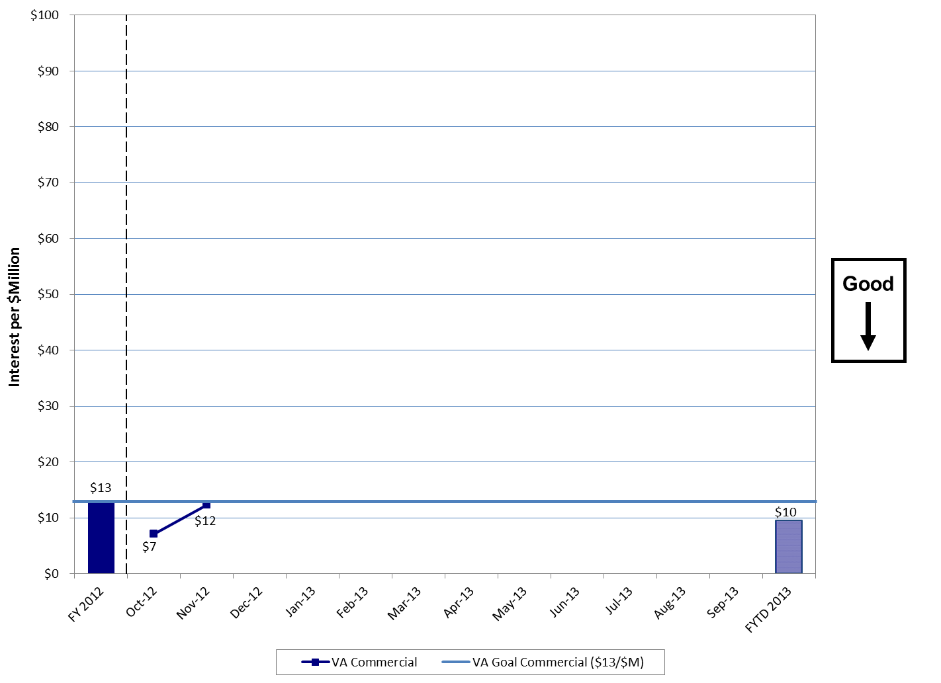
FY 2013 Interest per $Million Commercial Payments
Bottom Line:
VA Commercial Payments Interest Per Million (IPM) increased from $7 in October to $12 for November. However, FY 2013 represents an improvement over both the November 2011 (20 percent) and FY 2012 YTD (33 percent) performance periods.
Notes:
8
8

